Slide 1
REVISION
ARTIFICIAL INTELLIGENCE

Slide 2
What is Artificial Intelligence?
Father of Artificial Intelligence, John McCarthy, describes it as:
“The science and engineering of making intelligent machines, especially intelligent computer programs”.

Slide 3
Goal of AI
Create Expert Systems
Implement Human Intelligence in Machines
What is AI Technique?
AI Technique is a manner to organize and use the knowledge efficiently in such a way that −
It should be perceivable by the people who provide it.
It should be easily modifiable to correct errors.
It should be useful in many situations though it is incomplete or inaccurate.

Slide 4
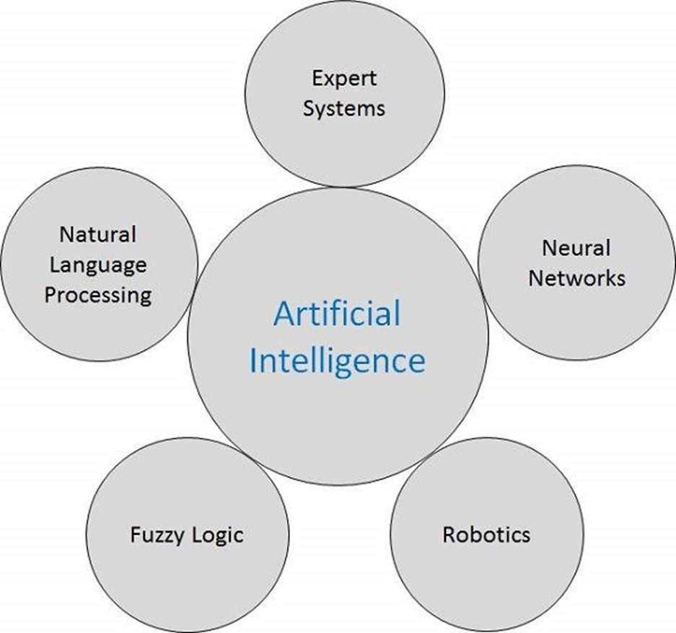
Application of AI
Gaming
Natural Language Processing
Expert Systems
Vision Systems
Speech Recognition
Handwriting Recognition
Intelligent Robots
Fuzzy Logic

Slide 5
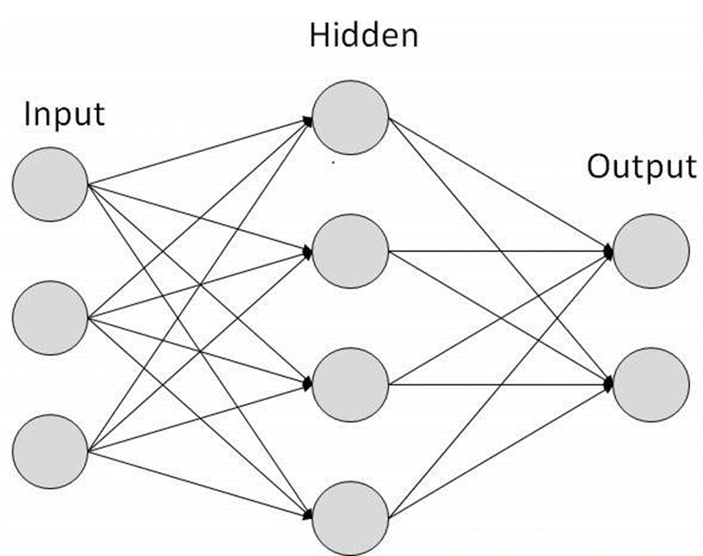
Artificial Intelligence - Neural Networks
What are Artificial Neural Networks (ANNs)?
The inventor of the first neurocomputer, Dr. Robert Hecht-Nielsen, defines a neural network as −
"...a computing system made up of a number of simple, highly interconnected processing elements, which process information by their dynamic state response to external inputs.”
Basic Structure of ANNs
The following illustration shows a simple ANN
Composed of multiple nodes, which imitate biological neurons of human brain.
The neurons are connected by links, and they interact with each other.
The nodes can take input data and perform simple operations on the data.
The result of these operations is passed to other neurons.
The output at each node is called its activation or node value.
Each link is associated with weight.
ANNs are capable of learning, which takes place by altering weight values.

Slide 6
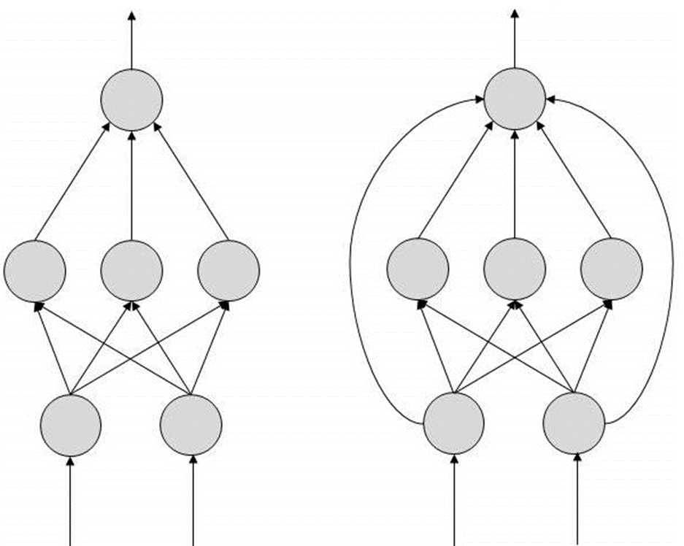
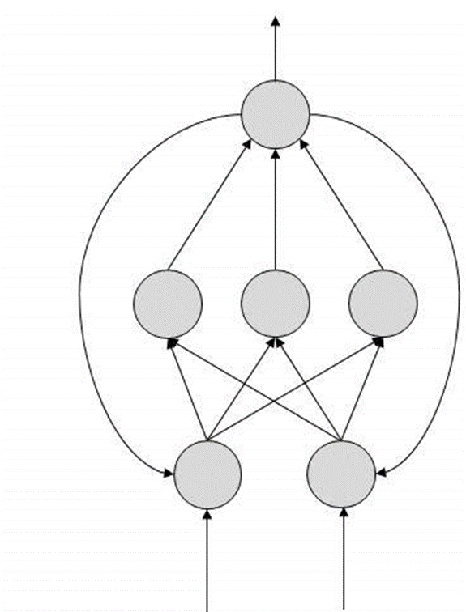
Types of Artificial Neural Networks
FeedForward ANN
FeedBack ANN

Slide 7
History of AI
1950 | Alan Turing introduced Turing Test for evaluation of intelligence and published Computing Machinery and Intelligence. Claude Shannon published Detailed Analysis of Chess Playing as a search.
1956 | John McCarthy coined the term Artificial Intelligence. Demonstration of the first running AI program at Carnegie Mellon University.

Slide 8
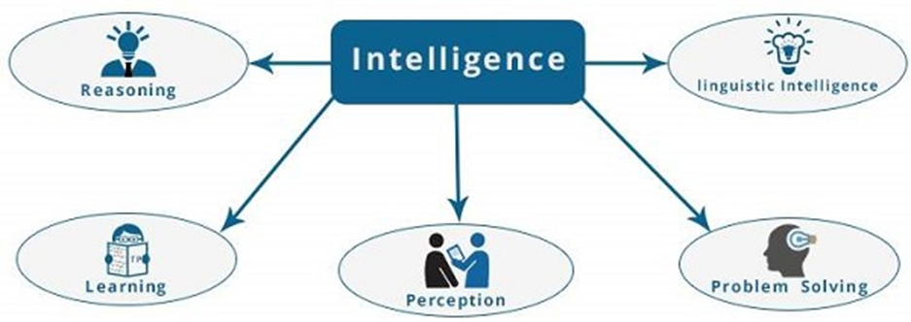
What is Intelligence Composed of?
The intelligence is intangible. It is composed of
Reasoning
Learning
Problem Solving
Perception
Linguistic Intelligence

Slide 9
• Reasoning − It is the set of processes that enables us to provide basis for judgement, making decisions, and prediction.
There are broadly two types :
Inductive Reasoning | Deductive Reasoning
It conducts specific observations to makes broad general statements. | It starts with a general statement and examines the possibilities to reach a specific, logical conclusion.
Even if all of the premises are true in a statement, inductive reasoning allows for the conclusion to be false. | If something is true of a class of things in general, it is also true for all members of that class.
Example − "Nita is a teacher. Nita is studious. Therefore, All teachers are studious." | Example − "All women of age above 60 years are grandmothers. Shalini is 65 years. Therefore, Shalini is a grandmother."

Slide 10
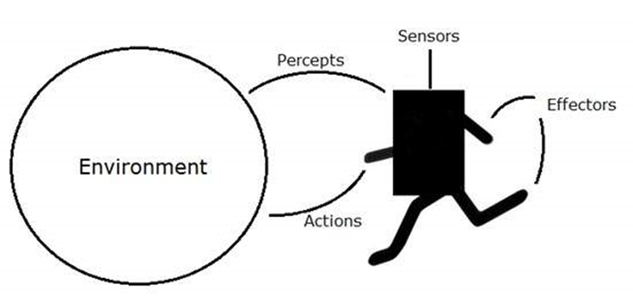
AI - Agents & Environments
An AI system is composed of an agent and its environment.
The agents act in their environment.
The environment may contain other agents.
An agent is anything that can perceive its environment through sensors and acts upon that environment through effectors.
A human agent has sensory organs such as eyes, ears, nose, tongue and skin parallel to the sensors, and other organs such as hands, legs, mouth, for effectors.
A robotic agent replaces cameras and infrared range finders for the sensors, and various motors and actuators for effectors.
A software agent has encoded bit strings as its programs and actions.

Slide 11
What is Ideal Rational Agent?
An ideal rational agent is the one, which is capable of doing expected actions to maximize its performance measure, on the basis of −
Its percept sequence
Its built-in knowledge base
Rationality of an agent depends on the following −
The performance measures, which determine the degree of success.
Agent’s Percept Sequence till now.
The agent’s prior knowledge about the environment.
The actions that the agent can carry out.
A rational agent always performs right action, where the right action means the action that causes the agent to be most successful in the given percept sequence. The problem the agent solves is characterized by Performance Measure, Environment, Actuators, and Sensors (PEAS).

Slide 12
PEAS REPRESENTATION
P: Performance measure
E: Environment
A: Actuators
S: Sensors
EXAMPLE 1: Self-driving car
PEAS representation will be:
Performance: Safety, time, legal drive, comfort
Environment: Roads, other vehicles, road signs, pedestrian
Actuators: Steering, accelerator, brake, signal, horn
Sensors: Camera, GPS, speedometer, odometer, accelerometer, sonar.
EXAMPLE 2:
PEAS description of a robot soccer player AND robot soccer team:

Slide 13
Performance measure (The output which we get from the agent): To play the soccer game, defend, attack, create goals and to win the soccer game.
Environment (All the surrounding things and conditions of an agent fall in this section): The soccer field with perimeters, team members, opposition team player, a referee, audience, ball.
Actuator (The devices, hardware or software through which the agent performs any actions or processes any information to produce a result are the actuators of the agent): Body of robot, Navigator, legs of robot, view detector for robot, tackling, passing ball, shooting.
Sensors (The devices through which the agent observes and perceives its environment): Camera, communicators (links among team members), sensors (orientation and touch). Camera locates the position of the ball on the floor.
Performance measure: Coordinated, play the soccer game as a team, defend and attack where it benefits the team, create and score goals in order to win the game. Each player is intended to perform their specific actions at the appropriate time and as a way of contributing to the overall action.
Environment (operational) software system that manages computer hardware and software resources: Opposing team. Communication infrastructure (wireless network for communication between team players). Software system (software systems must interact with external software components). Interaction mode, this is to achieve scalable agent environment, it is important to provide agents with efficient means for perceptions, actions, and interactions..
Actuator: Collaboration, Number of robots per team, Navigator, legs of robot (reflex motors), view detector for robot
Sensors: Camera, communicators (links among team members), sound sensors and touch sensors (for impact).

Slide 14
TYPES OF AGENTS
Simple Reflex Agent
Model-based reflex agent
Goal-based agents
Utility-based agent
Learning agent

Slide 15
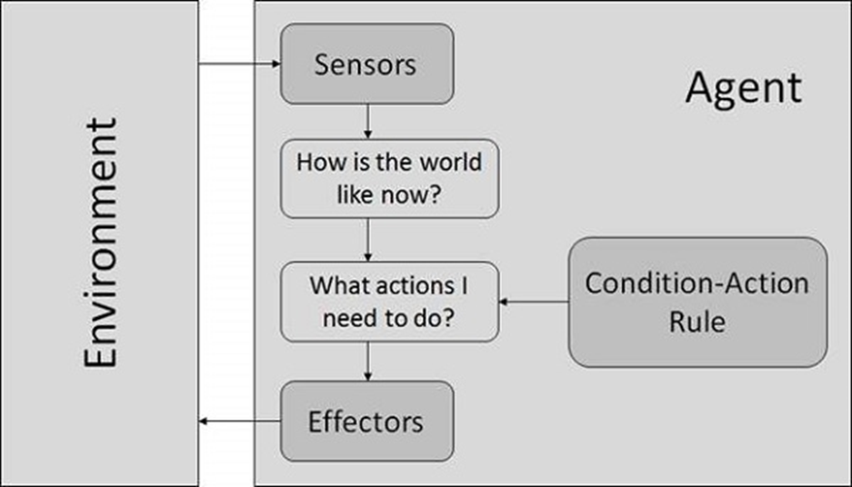
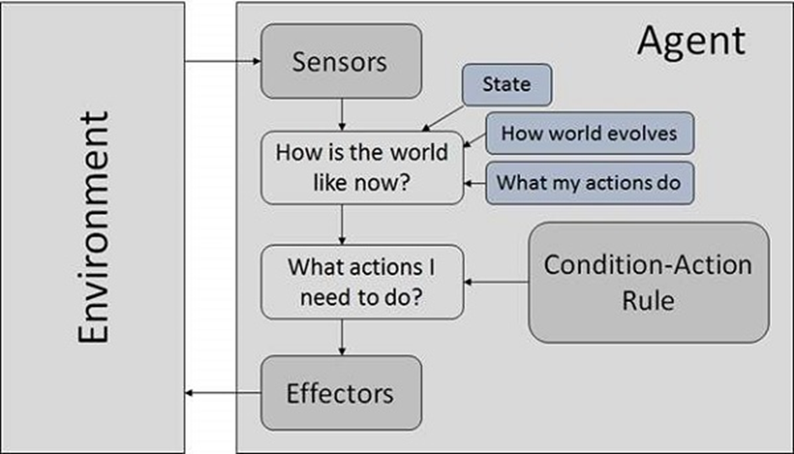
The Structure of Intelligent Agents
Condition-Action Rule − It is a rule that maps a state (condition) to an action.
Model Based Reflex Agents
They use a model of the world to choose their actions.

Slide 16
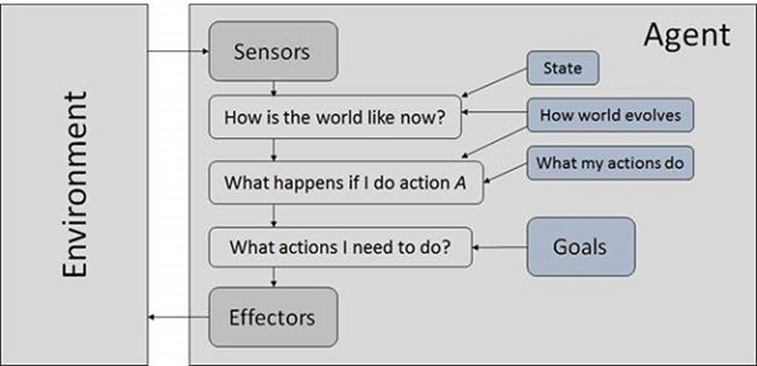
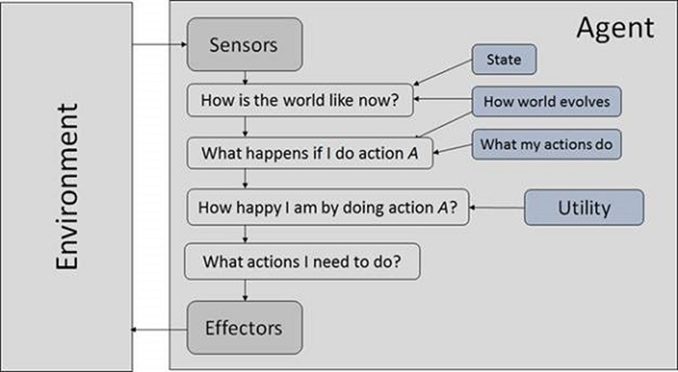
Goal Based Agents
They choose their actions in order to achieve goals.
Utility Based Agents
They choose actions based on a preference (utility) for each state.

Slide 17
Agent = Architecture + Agent program
Architecture: Architecture is machinery that an AI agent executes on.
Agent program: Agent program is an implementation of agent function. An agent program executes on the physical architecture to produce function f.

Slide 18
The Nature of Environments
Some programs operate in the entirely artificial environment confined to:
keyboard input
Database
Computer file systems
Character output on a screen.
In contrast, some software agents (software robots or softbots) exist in rich, unlimited softbots domains. The simulator has a very detailed, complex environment. The software agent needs to choose from a long array of actions in real time.
The most famous artificial environment is the Turing Test environment, in which one real and other artificial agents are tested on equal ground. This is a very challenging environment as it is highly difficult for a software agent to perform as well as a human.
Turing Test
The success of an intelligent behavior of a system can be measured with Turing Test.
Two persons and a machine to be evaluated participate in the test. Out of the two persons, one plays the role of the tester. Each of them sits in different rooms. The tester is unaware of who is machine and who is a human. He interrogates the questions by typing and sending them to both intelligences, to which he receives typed responses.
This test aims at fooling the tester. If the tester fails to determine machine’s response from the human response, then the machine is said to be intelligent.

Slide 19
Properties of Environment
Discrete / Continuous − If there are a limited number of distinct, clearly defined, states of the environment, the environment is discrete (For example, chess); otherwise, it is continuous (For example, driving).
Observable / Partially Observable − If it is possible to determine the complete state of the environment at each time point from the percepts it is observable; otherwise, it is only partially observable.
Static / Dynamic − If the environment does not change while an agent is acting, then it is static; otherwise, it is dynamic.
Deterministic vs Stochastic - If an agent's current state and selected action can completely determine the next state of the environment, then such environment is called a deterministic environment. A stochastic environment is random in nature and cannot be determined completely by an agent. In a deterministic, fully observable environment, agent does not need to worry about uncertainty.

Slide 20
Properties of Environment cont.
Single agent / Multiple agents − The environment may contain other agents which may be of the same or different kind as that of the agent.
Accessible / Inaccessible − If the agent’s sensory apparatus can have access to the complete state of the environment, then the environment is accessible to that agent.
Deterministic / Non-deterministic − If the next state of the environment is completely determined by the current state and the actions of the agent, then the environment is deterministic; otherwise, it is non-deterministic.
Episodic / Non-episodic − In an episodic environment, each episode consists of the agent perceiving and then acting. The quality of its action depends just on the episode itself. Subsequent episodes do not depend on the actions in.

Slide 21
AI - Popular Search Algorithms
Search Terminology
Problem Space − It is the environment in which the search takes place. (A set of states and set of operators to change those states)
Problem Instance − It is Initial state + Goal state.
Problem Space Graph − It represents problem state. States are shown by nodes and operators are shown by edges.
Depth of a problem − Length of a shortest path or shortest sequence of operators from Initial State to goal state.
Space Complexity − The maximum number of nodes that are stored in memory.
Time Complexity − The maximum number of nodes that are created.
Admissibility − A property of an algorithm to always find an optimal solution.
Branching Factor − The average number of child nodes in the problem space graph.
Depth − Length of the shortest path from initial state to goal state.

Slide 22
SEARCH
Searching is a step-by-step procedure to solve a search-problem in each search space.
A search problem can have three main factors:
Search Space: Search space represents a set of possible solutions, which a system may have.
Start State: It is a state from where agent begins the search.
Goal test: It is a function which observe the current state and returns whether the goal state is achieved or not.
COMPONENTS OF A SEARCH PROBLEM
Search tree
Actions
Transition model
Path Cost
Solution
Optimal Solution

Slide 23
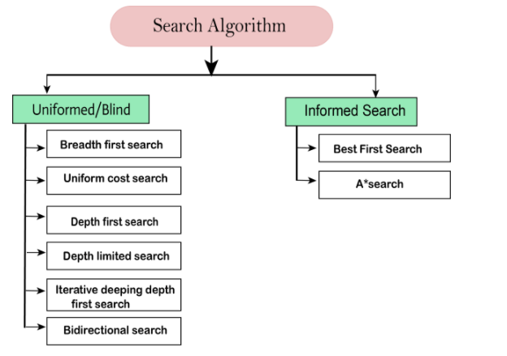
Types of search algorithms
Based on the search problems we can classify the search algorithms into uninformed (Blind search) search and informed search (Heuristic search) algorithms.

Slide 24
TYPES OF SEARCH ALGORITHMS
Brute-Force Search Strategies
Breadth-First Search
Depth-First Search
Bidirectional Search
Uniform Cost Search
Iterative Deepening Depth-First Search
Informed (Heuristic) Search Strategies
Heuristic Evaluation Functions
Pure Heuristic Search
Best First Search
The A Algorithm
The A* Algorithm
Greedy Best First Search
Local Search Algorithms
Hill-Climbing Search
Greedy Hill Climbing
Branch and Bound Techniques

Slide 25
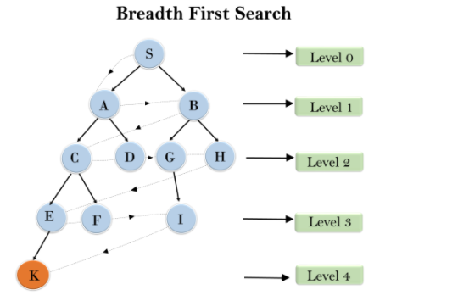
Breadth-first Search:
Breadth-first search is the most common search strategy for traversing a tree or graph.
This algorithm searches breadthwise in a tree or graph, so it is called breadth-first search.
BFS algorithm starts searching from the root node of the tree and expands all successor node at the current level before moving to nodes of next level.
The breadth-first search algorithm is an example of a general-graph search algorithm.
Breadth-first search implemented using FIFO queue data structure.
Advantages:
BFS will provide a solution if any solution exists.
If there are more than one solutions for a given problem, then BFS will provide the minimal solution which requires the least number of steps.
Disadvantages:
It requires lots of memory since each level of the tree must be saved into memory to expand the next level.
BFS needs lots of time if the solution is far away from the root node.

Slide 26
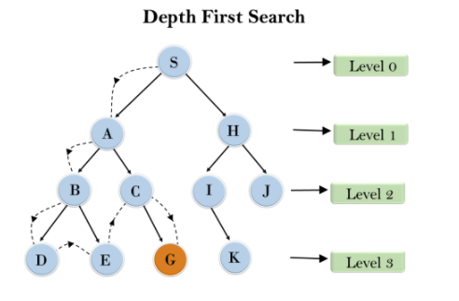
Depth-first Search
Depth-first search is a recursive algorithm for traversing a tree or graph data structure.
It is called the depth-first search because it starts from the root node and follows each path to its greatest depth node before moving to the next path.
DFS uses a stack data structure for its implementation.
The process of the DFS algorithm is like the BFS algorithm.
Advantage:
DFS requires very less memory as it only needs to store a stack of the nodes on the path from root node to the current node.
It takes less time to reach to the goal node than BFS algorithm (if it traverses in the right path).
Disadvantage:
There is the possibility that many states keep re-occurring, and there is no guarantee of finding the solution.
DFS algorithm goes for deep down searching and sometimes it may go to the infinite loop.

Slide 27
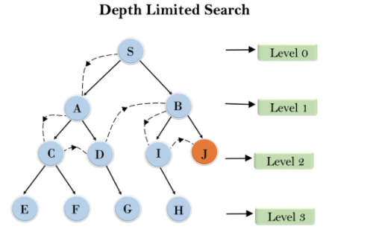
Depth-Limited Search Algorithm:
A depth-limited search algorithm is similar to depth-first search with a predetermined limit.
Depth-limited search can solve the drawback of the infinite path in the Depth-first search.
In this algorithm, the node at the depth limit will treat as it has no successor nodes further.
Depth-limited search can be terminated with two Conditions of failure:
Standard failure value: It indicates that problem does not have any solution.
Cutoff failure value: It defines no solution for the problem within a given depth limit.
Advantages:
Depth-limited search is Memory efficient.
Disadvantages:
Depth-limited search also has a disadvantage of incompleteness.
It may not be optimal if the problem has more than one solution.
Example:

Slide 28
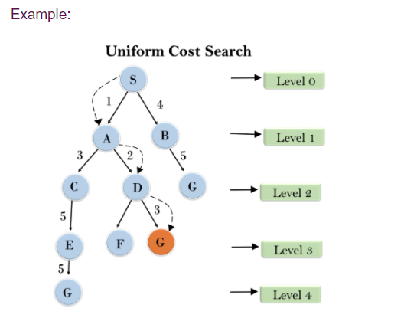
Uniform-cost Search Algorithm:
Uniform-cost search is a searching algorithm used for traversing a weighted tree or graph.
This algorithm comes into play when a different cost is available for each edge.
The primary goal of the uniform-cost search is to find a path to the goal node which has the lowest cumulative cost. Uniform-cost search expands nodes according to their path costs form the root node.
It can be used to solve any graph/tree where the optimal cost is in demand.
A uniform-cost search algorithm is implemented by the priority queue.
It gives maximum priority to the lowest cumulative cost.
Uniform cost search is equivalent to BFS algorithm if the path cost of all edges is the same.
Advantages:
Uniform cost search is optimal because at every state the path with the least cost is chosen.
Disadvantages:
It does not care about the number of steps involve in searching and only concerned about path cost. Due to which this algorithm may be stuck in an infinite loop.

Slide 29
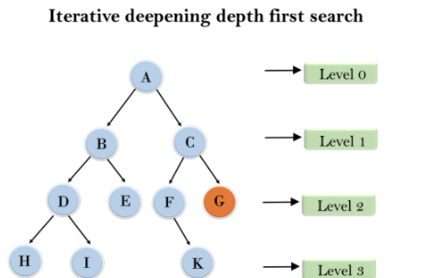
Iterative deepening depth-first Search:
The iterative deepening algorithm is a combination of DFS and BFS algorithms.
This search algorithm finds out the best depth limit and does it by gradually increasing the limit until a goal is found.
This algorithm performs depth-first search up to a certain "depth limit", and it keeps increasing the depth limit after each iteration until the goal node is found.
This Search algorithm combines the benefits of Breadth-first search's fast search and depth-first search's memory efficiency.
The iterative search algorithm is useful uninformed search when search space is large, and depth of goal node is unknown.
Advantages:
It combines the benefits of BFS and DFS search algorithm in terms of fast search and memory efficiency.
Disadvantages:
The main drawback of IDDFS is that it repeats all the work of the previous phase.

Slide 30
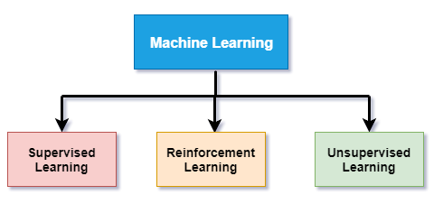
Types of Machine Learning

Slide 31
Supervised Learning
Method in which we provide sample labeled data to the machine learning system in order to train it, and on that basis, it predicts the output.
The system creates a model using labeled data to understand the datasets and learn about each data, once the training and processing are done then we test the model by providing a sample data to check whether it is predicting the exact output or not.
The goal of supervised learning is to map input data with the output data.
Supervised learning can be grouped further in two categories of algorithms:
Classification
Regression

Slide 32
Unsupervised learning
Method in which a machine learns without any supervision.
The training is provided to the machine with the set of data that has not been:
labeled
classified
Categorized
The algorithm needs to act on that data without any supervision.
The goal of unsupervised learning is to restructure the input data into new features or a group of objects with similar patterns.

Slide 33
Unsupervised learning cont.
Unsupervised learning does not have predetermined results.
The machine tries to find useful insights from the huge amount of data.
It can be further classifieds into two categories of algorithms:
Clustering
Association

Slide 34
Reinforcement Learning
Reinforcement learning is a feedback-based learning method, in which a learning agent gets a reward for each right action and gets a penalty for each wrong action.
The agent learns automatically with these feedbacks and improves its performance.
In reinforcement learning, the agent interacts with the environment and explores it.
The goal of an agent is to get the most reward points, and hence, it improves its performance.
The robotic dog, which automatically learns the movement of his arms, is an example of Reinforcement learning.

Slide 35
Machine Learning in ANNs
ANNs are capable of learning, and they need to be trained. There are several learning strategies:
Supervised Learning
Unsupervised Learning
Reinforcement Learning
Bayesian Networks (BN)
These are the graphical structures used to represent the probabilistic relationship among a set of random variables.
Bayesian networks are also called Belief Networks or Bayes Nets.
BNs reason about uncertain domain.

Slide 36
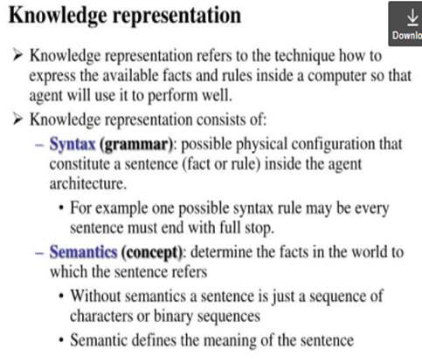
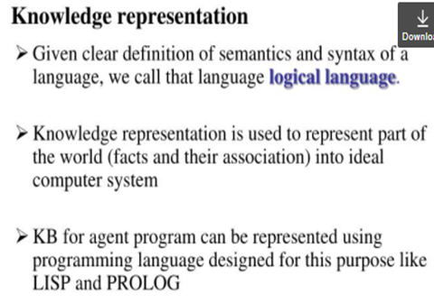
End of Previous slides
PROLOG, Java, LISP are commonly used programming languages for AI.

Slide 37
What is an expert system?
“An expert system is a computer system that emulates, or acts in all respects, with the decision-making capabilities of a human expert.”
Professor Edward Feigenbaum
Stanford University
Can be considered declarative languages:
Programmer does not specify how to achieve a goal at the algorithm level.
Induction-based programming – the program learns by generalizing from a sample.
Notes:
What is an Expert System?
An expert system is a computer program that is designed to solve complex problems and to provide decision-making ability like a human expert. It performs this by extracting knowledge from its knowledge base using the reasoning and inference rules according to the user queries.
The expert system is a part of AI, and the first ES was developed in the year 1970, which was the first successful approach of artificial intelligence. It solves the most complex issue as an expert by extracting the knowledge stored in its knowledge base. The system helps in decision making for complex problems using both facts and heuristics like a human expert. It is called so because it contains the expert knowledge of a specific domain and can solve any complex problem of that particular domain. These systems are designed for a specific domain, such as medicine, science, etc.
The performance of an expert system is based on the expert's knowledge stored in its knowledge base. The more knowledge stored in the KB, the more that system improves its performance. One of the common examples of an ES is a suggestion of spelling errors while typing in the Google search box.

Slide 38
EXPERT SYSTEMS
Components of Expert System
User Interface
Inference Engine
Knowledge Base
Factual knowledge
Heuristic knowledge
An expert’s knowledge is specific to a problem domain – medicine, finance, science, engineering, etc.

Slide 39
Uncertainty
Both human experts and expert systems must be able to deal with uncertainty.
It is easier to program expert systems with shallow knowledge than with deep knowledge.
Shallow knowledge – based on empirical and heuristic knowledge. Basic or general understanding of a subject.
Deep knowledge – based on basic structure, function, and behavior of objects.
Notes:
Uncertainty and Fuzzy Logic
Fuzzy logic is a method of reasoning that resembles human reasoning since it allows for approximate values and inferences and incomplete or ambiguous data (fuzzy data). Fuzzy logic is a method of choice for handling uncertainty in some expert systems.
Expert systems with fuzzy-logic capabilities thus allow for more flexible and creative handling of problems. These systems are used, for example, to control manufacturing processes.

Slide 40
Bayesian Network
A Bayesian network graph is made up of nodes and Arcs (directed links), where:
Each node corresponds to the random variables, and a variable can be continuous or discrete.
Arc or directed arrows represent the causal relationship or conditional probabilities between random variables. These directed links or arrows connect the pair of nodes in the graph.
These links represent that one node directly influence the other node, and if there is no directed link that means that nodes are independent with each other.

Slide 41
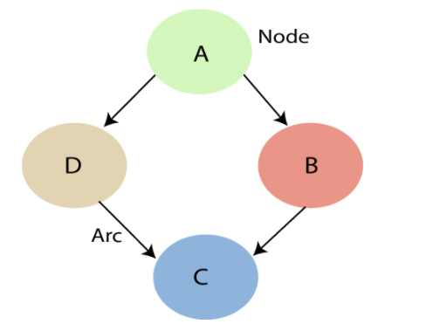
In the above diagram, A, B, C, and D are random variables represented by the nodes of the network graph.
If we are considering node B, which is connected with node A by a directed arrow, then node A is called the parent of Node B.
Node C is independent of node A.

Slide 42
Uncertainty cont.
Probability theory
The main tool for dealing with degrees of belief
Probabilities express the agent’s inability to reach a definite decision regarding the truth of a sentence.
Probabilities summarize the agent’s beliefs relative to the evidence.
Utility theory
Used to represent and reason with preference
UTILITY used in this context is “the quality of being useful,” / practical
AGENT needs PREFERENCE of which possible outcome it prefers among the various plans.
Every state has a degree of usefulness/ utility to an agent
Agent will prefer states with higher utility
The utility of a state is relative to an agent.
Decision Theory
Preferences, that are expressed by utilities, are combined with probabilities in the general theory of rational decisions
Decision theory = probability theory + utility theory
The fundamental idea of decision theory is that an agent is rational if and only if it chooses the action that yields the highest expected utility, averaged over all the possible outcomes of the action

Slide 43
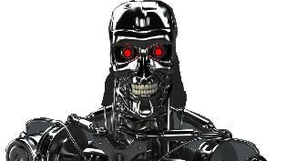
IMPLICATIONS OF AI Popular Visions of a Human-A.I. Future
FEARS
Superintelligence
Robot Overlords
Skynet Scenarios
A Jobless Future
The WALL-E Dystopia
HOPES
Humanity Amplified
Humanity Unbound
AI-Human Partnerships
The Recovery of Leisure
New ‘Age of Reason’

Slide 44
General Social issues with AI:
Loss of control
Threat to:
Safety and security
Privacy
Human Dignity
Bias and inequality
Responsibility, accountability and explain ability

Slide 45
Journey towards responsible AI
Create a space that allows people to voice their questions and concerns
Know what to look for, or at least where to start
Diversify team - Meet people where they are, not where you want them to be
Have the courage to adapt as you learn
Responsible AI is everyone’s responsibility

Slide 46
Practices that can help navigate moral dilemmas created by autonomous and intelligent systems:
Introducing ethical AI principles
Epistemic principles
General ethical AI principles
Contextualizing ethical AI principles
Linking ethical AI principles to human rights and organizational values

